Slide 1
Python Environment Setup

Slide 2
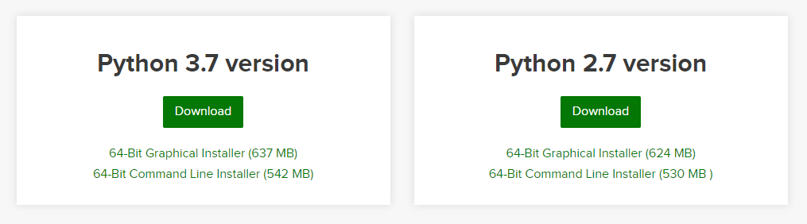
Installation of Python Anaconda[Jupyter]
Steps:
Navigate to Anaconda’s Download Webpage:
Link : https://www.anaconda.com/distribution/
Select the corresponding Operating System and then get Python 3 Version of installer
Execute the Installer in Admin mode.
Once Installation is Completed you should be able to see Jupyter Notebook.
It Should open a browser with Notebook layed out for Code Execution
Jupyter: Quick Overview

Slide 3
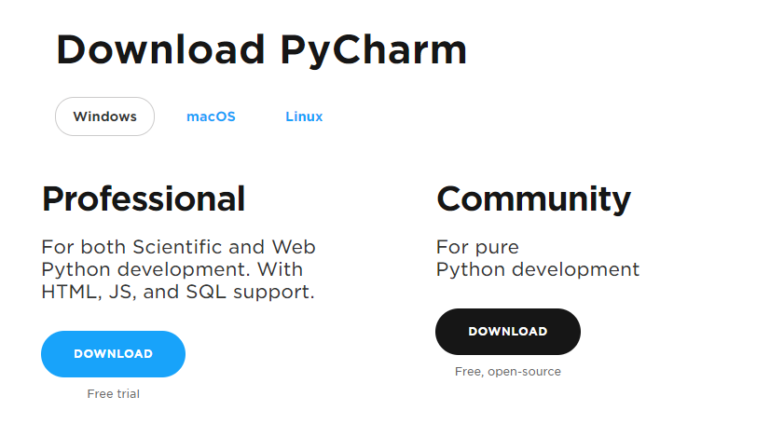
Installation of Python Pycharm IDE
Steps:
Navigate to Anaconda’s Download Webpage:
Link : https://www.jetbrains.com/pycharm/download/#section=windows
Download the Community Edition
Execute the Installer in Admin mode.
Once Installation is Completed you should be able to see Pycharm.

